Slide 1
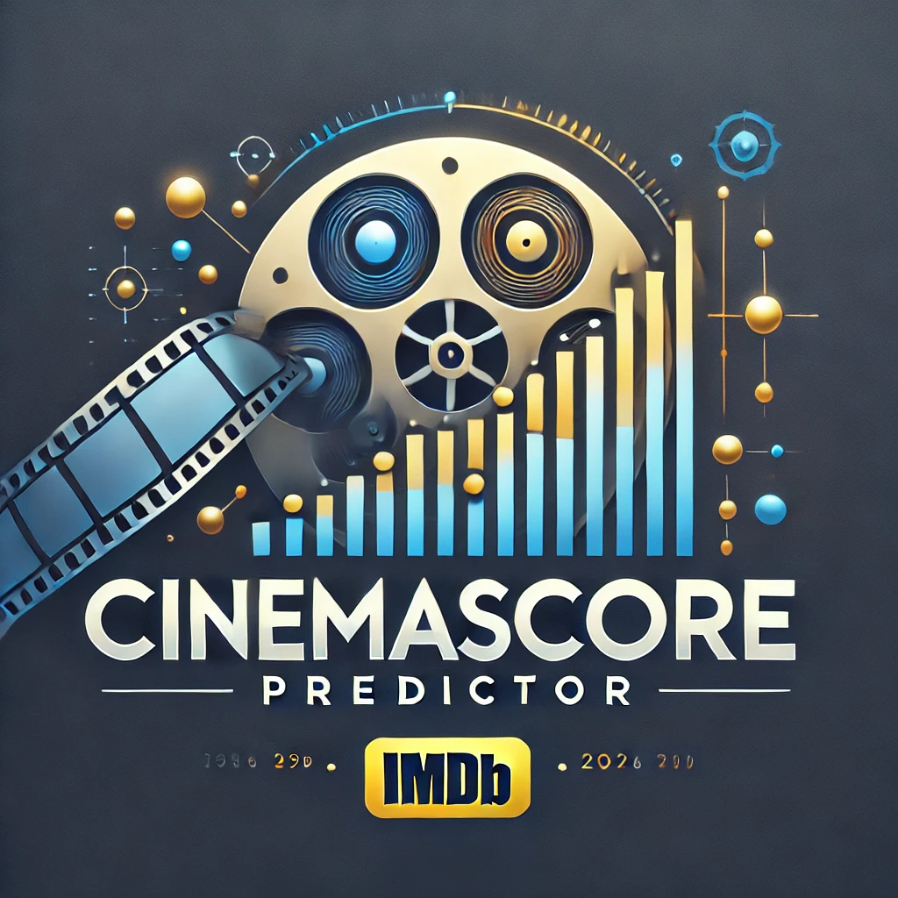
CinemaScore Predictor: An AI Model for IMDb Score Prediction
Fredy Aguirre
Ketan Parekh
Brian Hansen-Turton
Alan Hunt
Notes:
Welcome to the Cinema Score Predictor unveiling.
Our team members include:
Fredy Aguirre Who could not be with us tonight due to a pressing international matter.
Ketan Parekh
Brian Hansen-Turton
And myself - Alan

Slide 2

Concept and Motivation
Challenges in the Film Industry
Success in the competitive film industry requires a strategic understanding of audience preferences and movie dynamics.
Development of CinemaScore Predictor
An innovative tool designed to forecast IMDb scores and provide actionable insights into audience reception.
Helps identify key elements for predicting a movie’s critical and financial potential before production begins.
Strategic Team Investment
Leveraged the team’s expertise and financial success from a previous project to develop this groundbreaking solution.
Notes:
Fredy grew up with a passion for filmmaking and dreams of becoming a movie producer. However, the challenges of navigating the highly competitive film industry inspired a new approach—understanding the key factors that drive a movie's success. This led to the creation of the CinemaScore Predictor, an innovative tool powered by Artificial Intelligence. Designed to forecast IMDb scores and provide data-driven insights, the tool offers producers a strategic advantage by predicting audience engagement and satisfaction.
After achieving significant success with our traffic accident analysis software, our team reinvested in this vision. Together, we are working to identify the tangible elements that predict a movie's potential for critical or financial success—even before the first script is written.

Slide 3
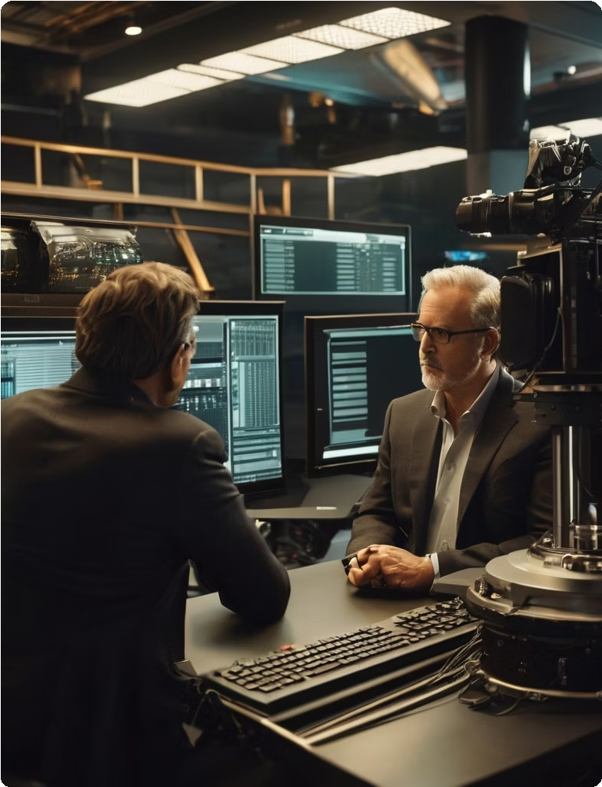
Value of IMDb Scores
High IMDb scores reflect strong audience engagement and satisfaction.
Key Predictive Factors
AI leverages factors such as director, actors, genre, and rating to forecast IMDb scores.
Actionable Insights
The CinemaScore Predictor provides filmmakers with data-driven insights for crafting audience-focused films.
Empowering Filmmakers
Equips producers and filmmakers with advanced tools to make informed decisions.
Aims to deliver memorable cinematic experiences that resonate with audiences.
Notes:
A high IMDb score serves as a valuable indicator of audience engagement and satisfaction. Predicting an IMDb score based on director, actors, genre, and rating provides a strong foundation for success. Leveraging Artificial Intelligence, the CinemaScore Predictor offers producers and filmmakers actionable insights, enabling them to craft films that truly resonate with audiences. This innovative tool seamlessly blends artistic vision with data-driven strategies, enhancing the likelihood of success in an unpredictable industry. Our vision is to empower producers and filmmakers with cutting-edge AI tools to make informed decisions and deliver memorable cinematic experiences that captivate viewers.

Slide 4

Data Exploration and Cleanup
Data Exploration
Exploratory data analysis (EDA) is performed to understand patterns and correlations within the dataset. Techniques such as visualization and summary statistics are used to gain insights into the data's structure and content.
Data Cleanup
Data cleaning involves removing duplicates, handling missing values, and standardizing data formats. This step is crucial to ensure data accuracy and reliability for model training.
Notes:
We selected an IMDb dataset from Kaggle, which provided a diverse range of movie-related features for analysis. Key attributes included IMDb scores, director and actor names, genres, ratings, Facebook likes, duration, gross revenue, budget, and more. This dataset served as a robust foundation for identifying patterns and developing predictive models to estimate IMDb scores. Before proceeding with analysis, we examined the features and their distributions using visualizations. This exploration guided us in implementing steps such as removing duplicates, handling missing values, and standardizing data formats. These preprocessing steps were essential for understanding the dataset's key characteristics and addressing issues like missing data, outliers, and imbalances.

Slide 5
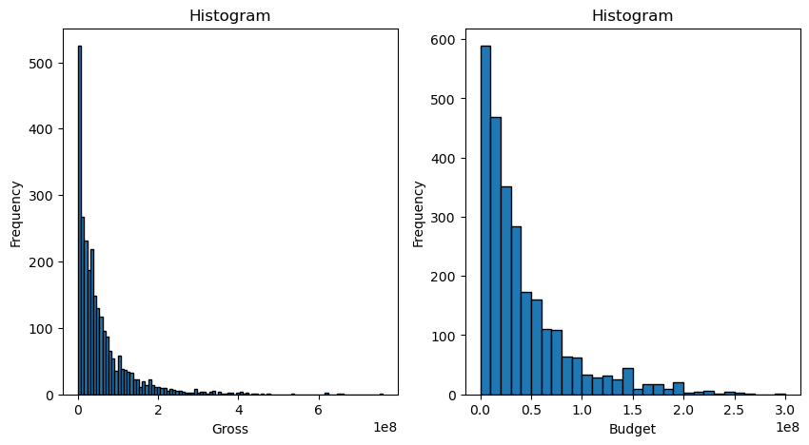
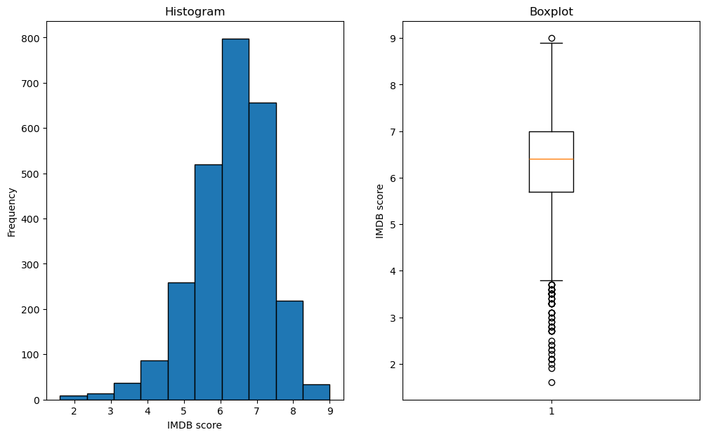
Cleanup Challenges
Missing Data
Outliers
Notes:
The visualizations revealed that some columns contained missing data and outliers. For example, the histogram and box plot highlighted these issues, demonstrating the challenges present in the data set

Slide 6
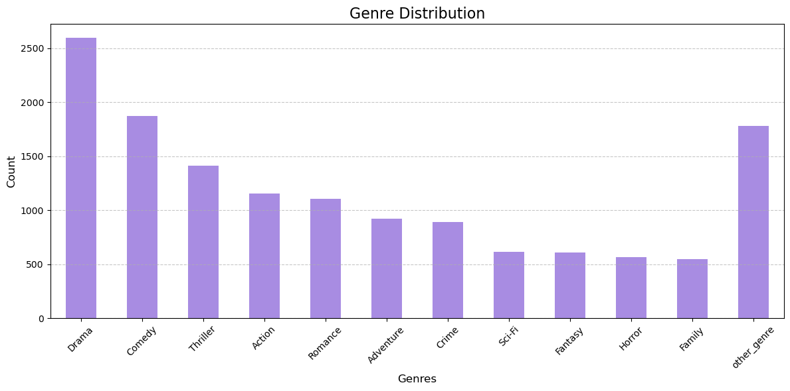
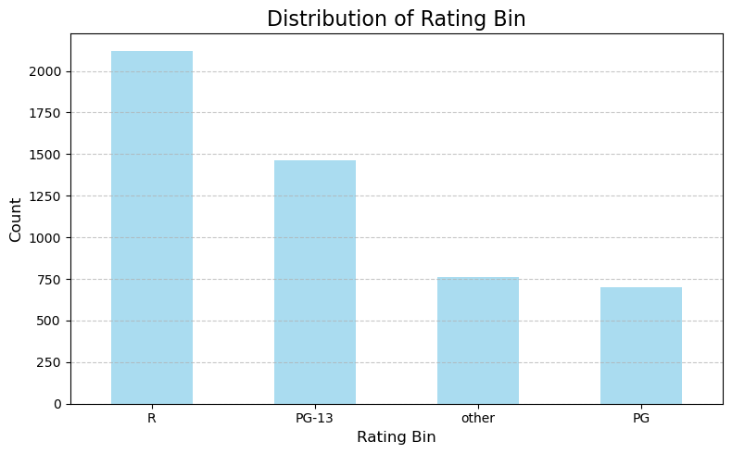
Cleanup challenges
Genre
Content Rating
Notes:
For instance, low-frequency (10% Or less) categories in features like genres and ratings were grouped into an "Other" category to simplify the analysis.

Slide 7

Cleanup Challenges
Missing Values
Actor_1_Name
Actor_2_Name
Actor_3_Name
Director
Filter
Gross Budget
Language
Country
Drop Columns
Movie Title
Movie URL
Plot keywords
Notes:
During preprocessing, we addressed several challenges. Missing actor names were replaced with placeholders such as "Actor_1" and "Actor_2," while missing director names were substituted with "Director_1." To ensure the data was more meaningful and consistent, we filtered the dataset to include only movies with gross revenue and budgets exceeding $1,000. Additionally, we focused on English-language movies produced in the USA, minimizing variability caused by global outliers and imbalances. We also dropped movie URL and plot keywords as we rationalized they were not meaningful in predicting the IMDb score Finally, after completing these preprocessing steps, any remaining NaN values were removed. This reduced the dataset from over 5,000 rows to 2,700, resulting in a cleaner and more balanced dataset for analysis.

Slide 8
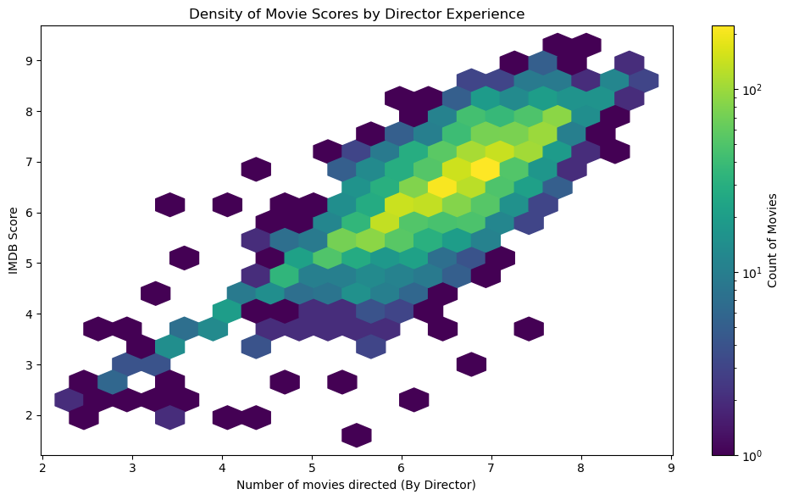
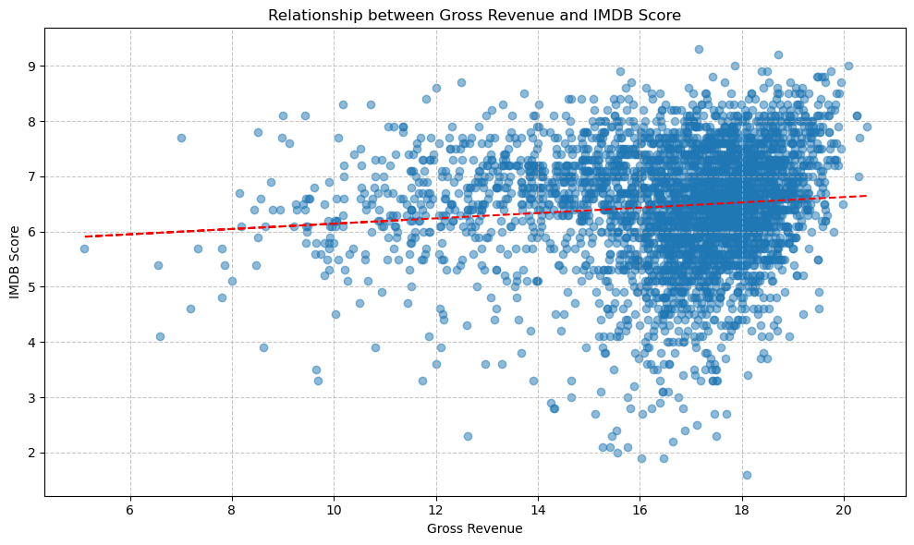
Modeling
Initial Findings
Revenue Trend with Score
Notes:
Thak you Brian:
Our initial analysis on pre processed data suggested promising findings aligning with our purpose of the project.
There are more dense rating around more experience with directing a movie
Trend displayed increase in revenue with imdb score increase.
Since this is a creative space there always will be disconnected findings

Slide 9
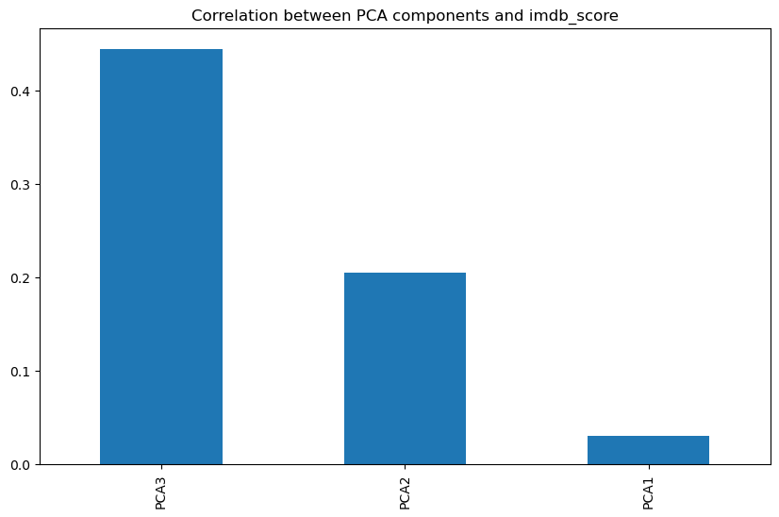
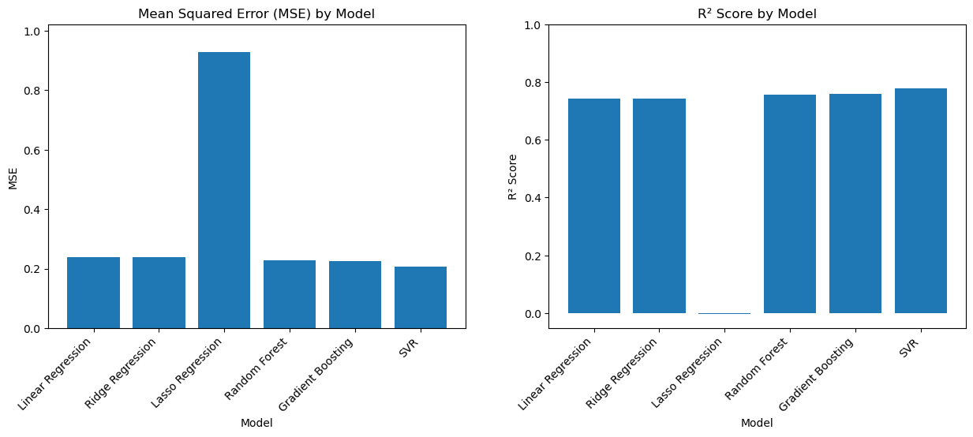
Modeling
Correlations and PCA
Model Performance
Pre-data processing and PCA
No apparent linearity
Random Forest, Gradient Boost and SVR looked promising
Notes:
Since we had considerably high number of features to relate with IMDB score, we tried to do a Principle Component Analysis, which really did not help much.
Also we tried several models and compared their performance metrics to identify a model to train with our data, Our natural instinct of using LASSO was denied by the scores and we leaned towards using Random Forest, Gradient Boost and SVR

Slide 10
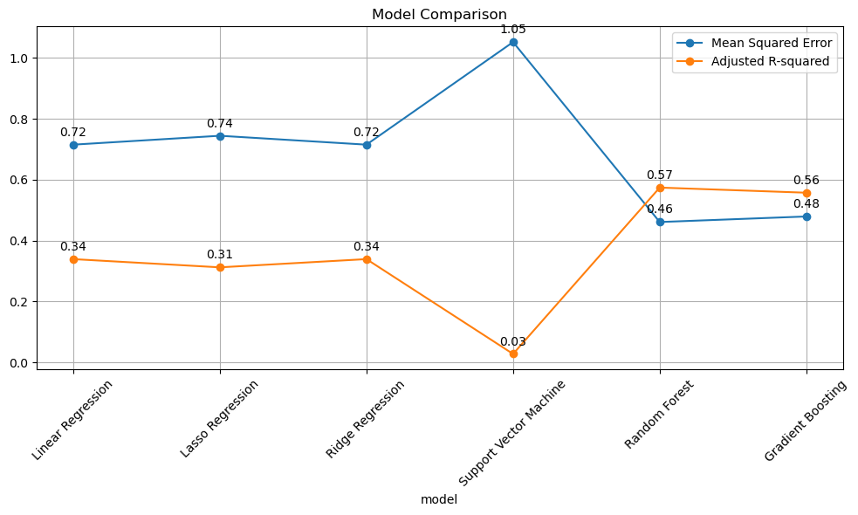
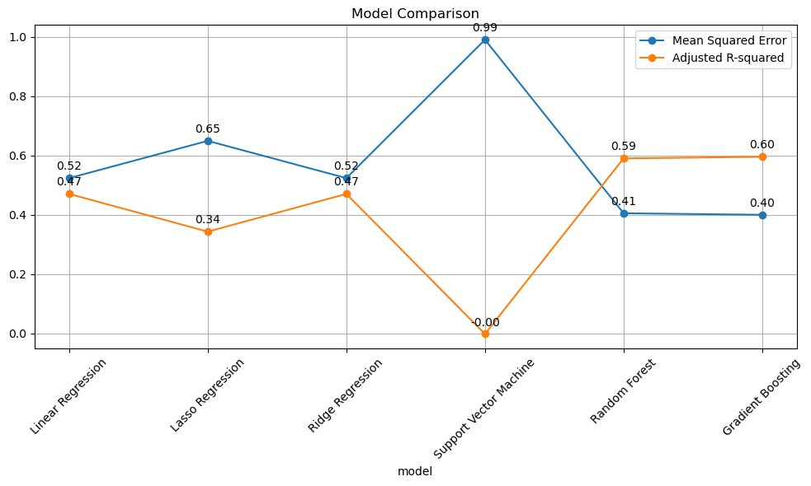
Modeling
Initial Model Analysis
Post Data Processing
Notes:
After doing required clenups and encoding we observed a slightly better picture of choice on our models. SVM performed worse while Gradient Boosting showed a performance very close to our target of 60% of desired score.

Slide 11

Modeling
Linear Regression Metrics
Mean Squared Error | 0.523458
R Squared | 0.497103
Adjusted R Squared | 0.470216
Gradient
Boost
Gradient Boost Regressor Metrics
Mean Squared Error | 0.398399
R Squared | 0.617250
Adjusted R Squared | 0.596786
Notes:
These are the comparison of Linear Regression versus Gradient Boost Regressor models which helped us decide our model for training our dataset. However, we are still open to train multiple models as we acquire better datasets before finalizing our choice of model for final product. Next, we will showcase what lies ahead of us in future development. Over to Alan… KP over and out.

Slide 12

Next Steps: Future Research and Development
Research Areas
Use social media sentiment analysis for better predictions.
Assess international market influence on scores.
Development Plan
Broaden film datasets with more IMDb data.
Add a feedback loop for real-time model updates.
Partner with experts to validate predictions.
Focus on niche genres and global films.
Notes:
To enhance the accuracy and reliability of the CinemaScore Predictor, several future developments are being prioritized. First, integrating social media sentiment analysis will help capture real-time audience opinions, refining prediction accuracy. Additionally, exploring the impact of international markets will allow the model to account for diverse cultural and regional preferences. A comprehensive dataset, incorporating a wider range of film databases and IMDb scores, will provide a solid foundation for broader applicability. Implementing a feedback loop based on real-time data and user inputs will enable continuous model refinement. Collaborating with industry experts will validate predictions and enhance credibility, while extending the model to include niche genres and international films will ensure its versatility and global relevance. These efforts aim to establish the CinemaScore Predictor as an indispensable tool for filmmakers worldwide.

Slide 13


GitHub Repository Explore the CinemaScore Predictor Code
Venture Capital Inquires
Notes:
Brian

Slide 14

Acknowledgments Suzanna Ayash For her unparalleled brilliance, destined to one day earn a Nobel Prize in Economics. Jimmy Tran For his unwavering dedication and exceptional guidance in leading us through this class. Honorable Mention John Ellis For effortlessly winning the admiration and affection of our group.

Slide 15
CinemaScore Predictor Demonstration

